Slide 1
Interim Report Presentation
Sign Language Interpreter

Slide 2
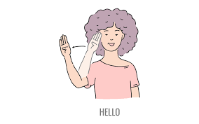
Introduction
Sign language is a primary means of communication for more than 400,000 people as they are deaf or have hearing problems
There is a need for technology-based solutions to help bridge to communicate
This system uses Python ,Keras , Deep Learning, Django and SQLite to convert video and image data into text.
The system is still under development, but it has potential to shorten distance between sign language user and non-user.

Slide 3
Aims
To introduce my sign language interpreter and its potential benefits.
To use Machine learning to create accurate system.
To share my research finding and help deaf community

Slide 4
Objective
To introduce a sign language interpreter system that uses Python, Keras, Deep Learning, Django and SQLite to convert video and image to text form.
To discuss the challenges of developing a system and how they were addressed.
To share the research finding and insights with the deaf community.

Slide 5
Requirement Engineering

Slide 6
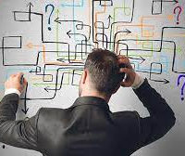
Problems
Communication Barrier
Accessibility
Lack of interpreters
Cost
The need for real-time translation

Slide 7
Solution
Create larger annotated dataset
Use noise reduction techniques
Use Machine learning to improve accuracy
User variety of data sources

Slide 8
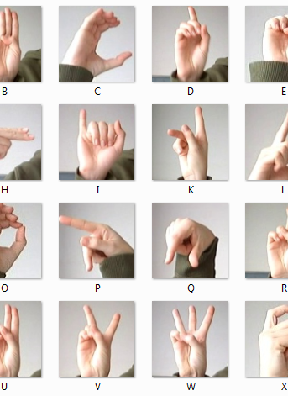
Requirement specification
User Registration and Authentication
Sign language Detectation
Video tutorial for learning
Search and Advance filter
Security and Data Privacy
User-Friendly interface

Slide 9
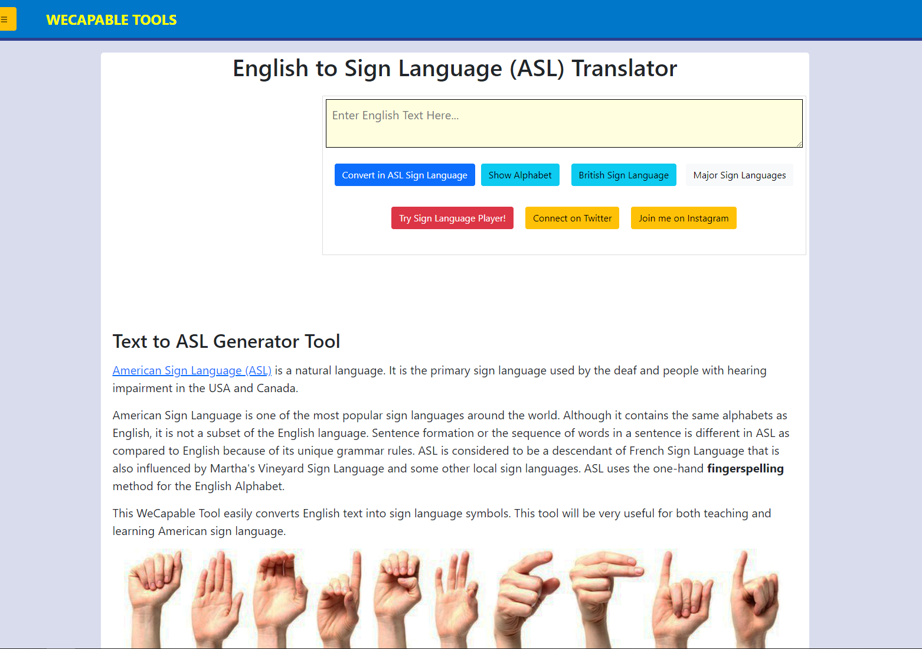
Comparable System
Wecapable tools

Slide 10
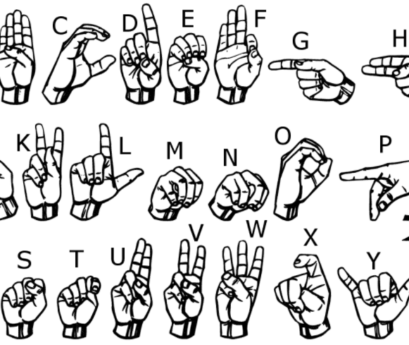
Potential Benefit
Improved communications
Increased Accessibility
Reduced Costs
Improved education
Increase awareness od deaf culture

Slide 11
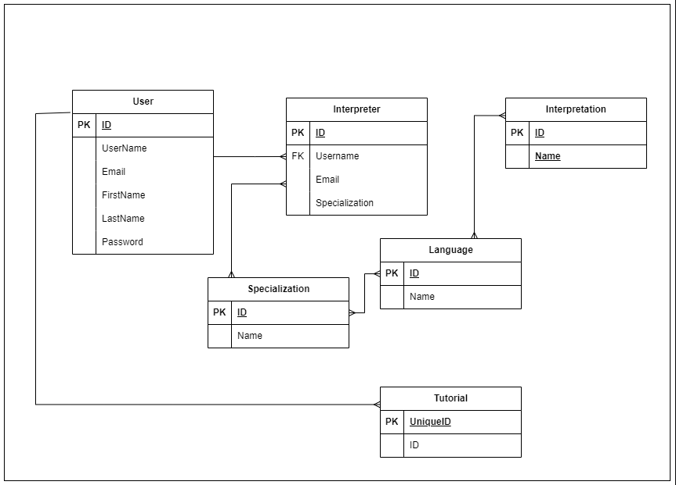
Diagrams

Slide 12
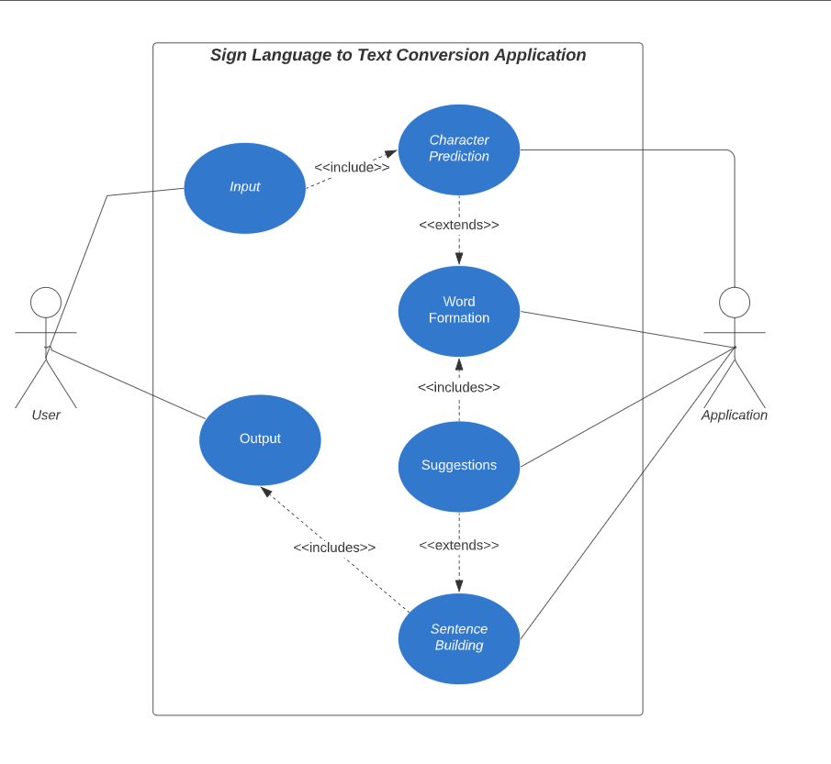

Slide 13
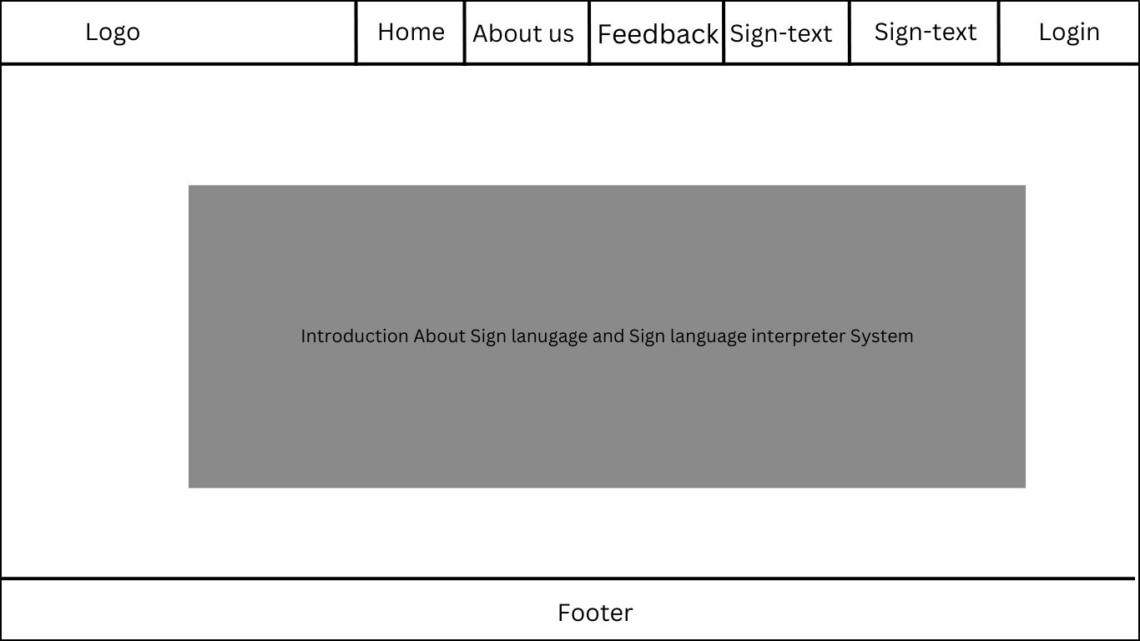
System Interface and Design

Slide 14
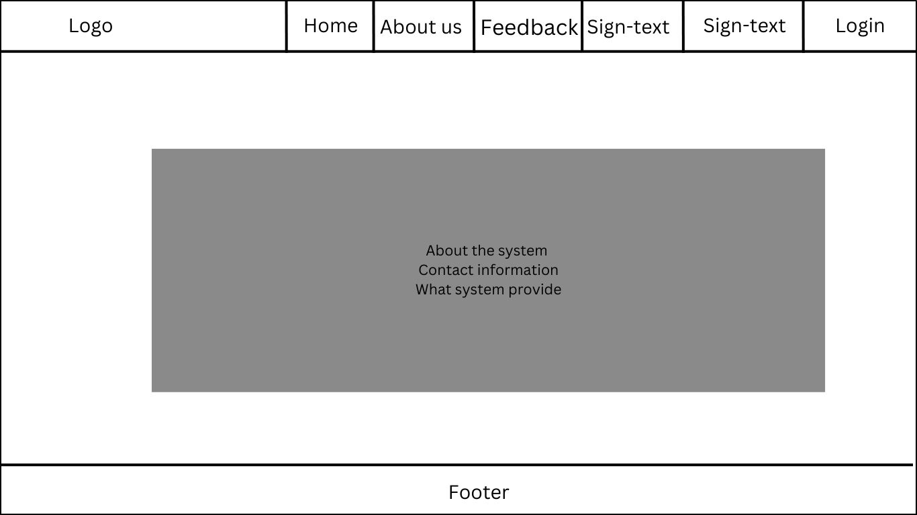

Slide 15


Slide 16
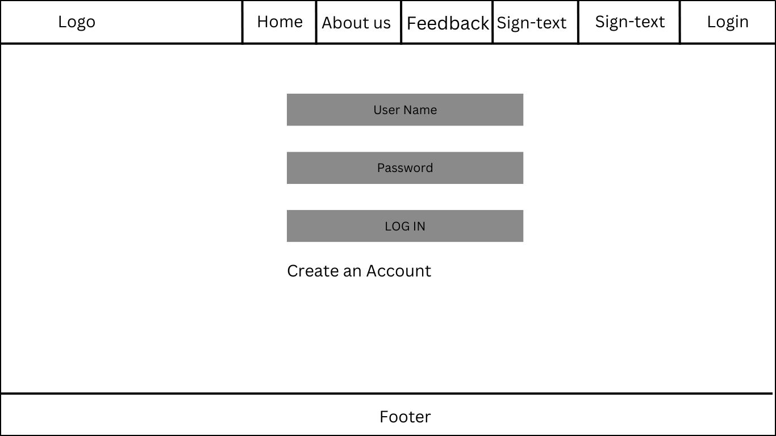

Slide 17
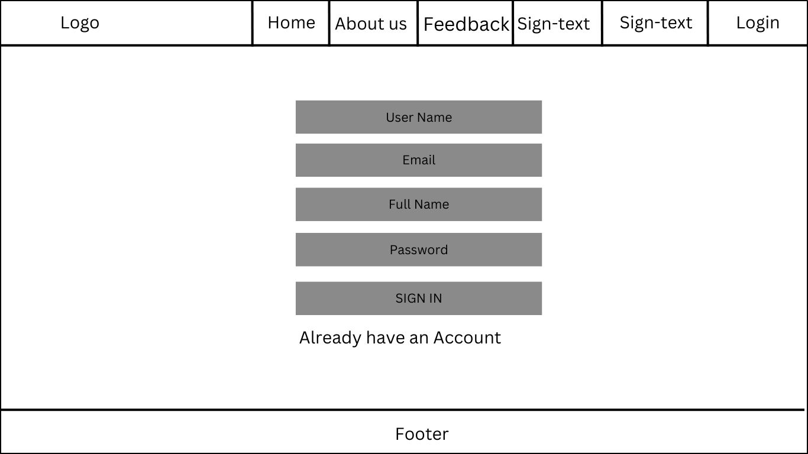

Slide 18
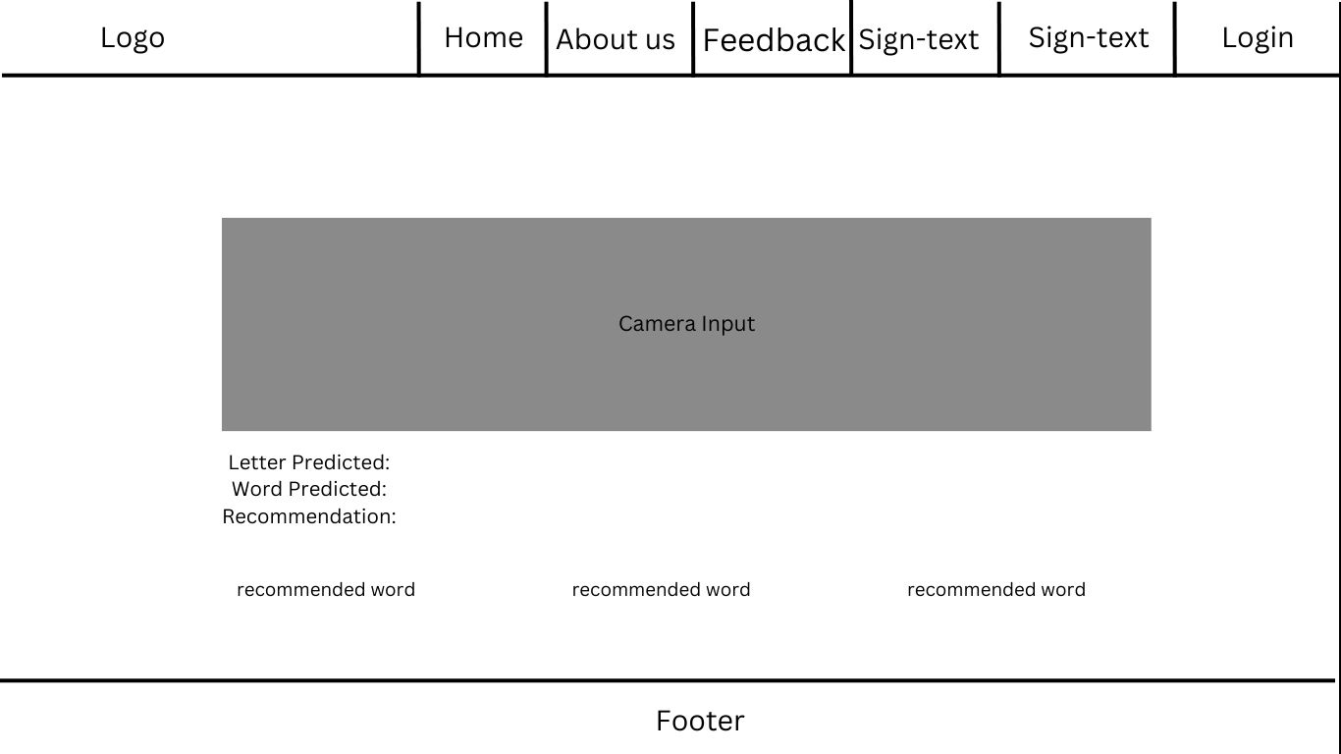

Slide 19
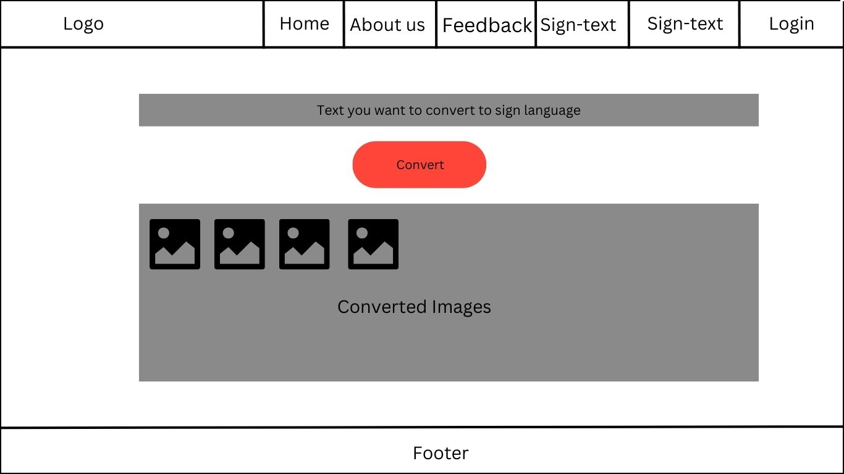

Slide 20
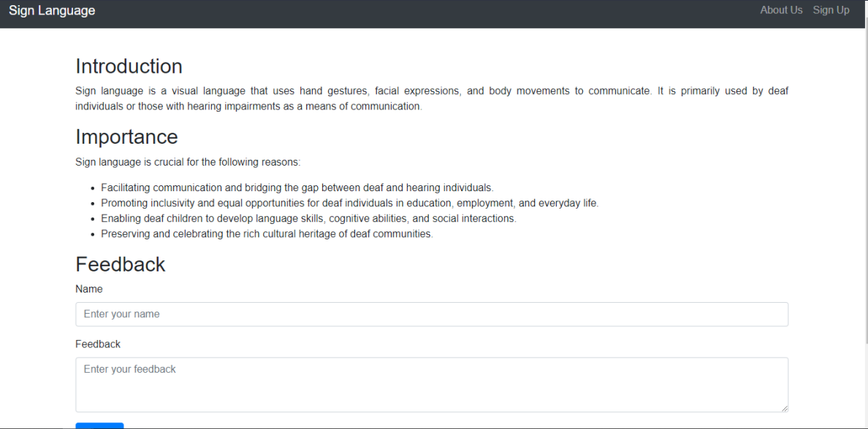
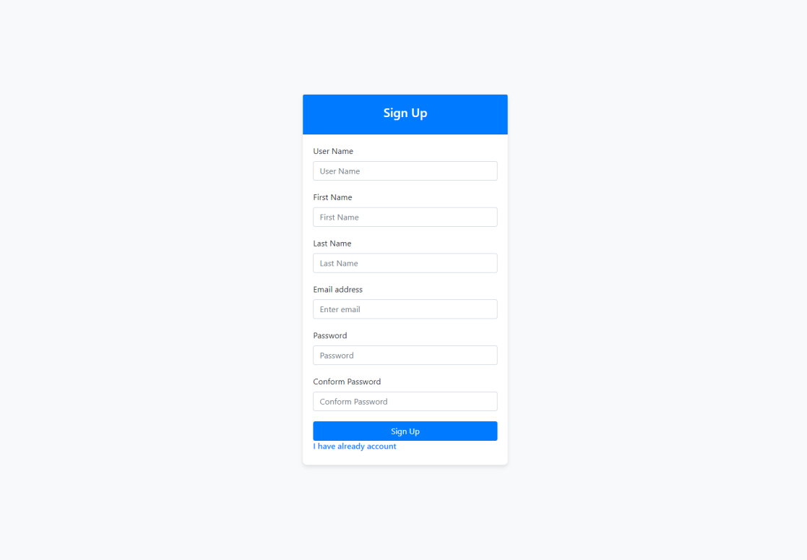
Mock up

Slide 21
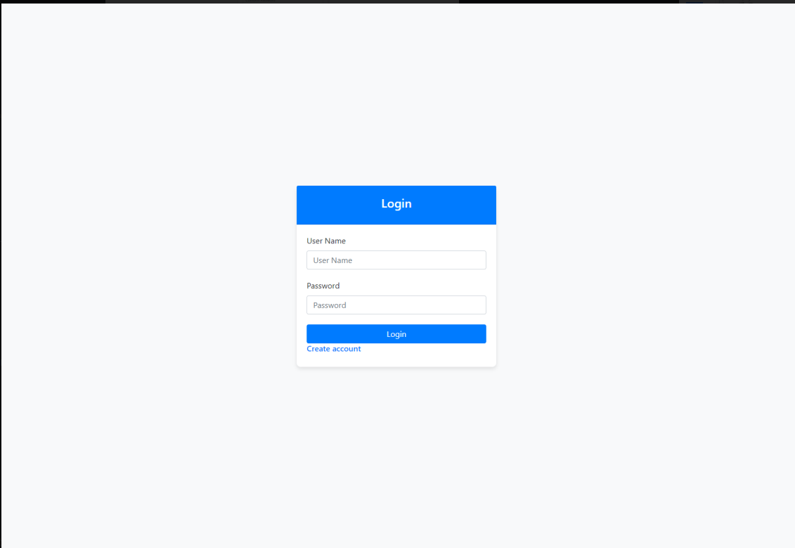
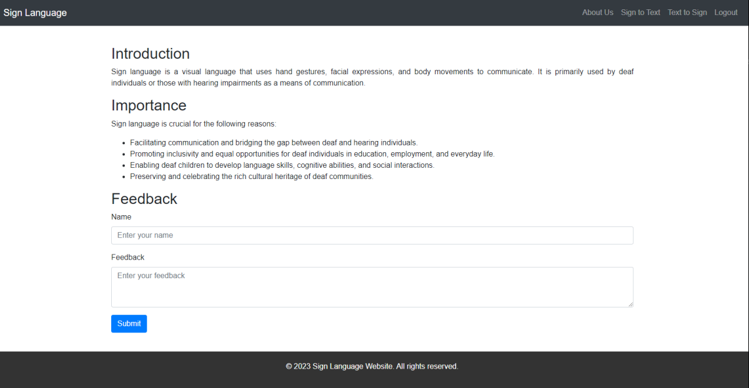

Slide 22
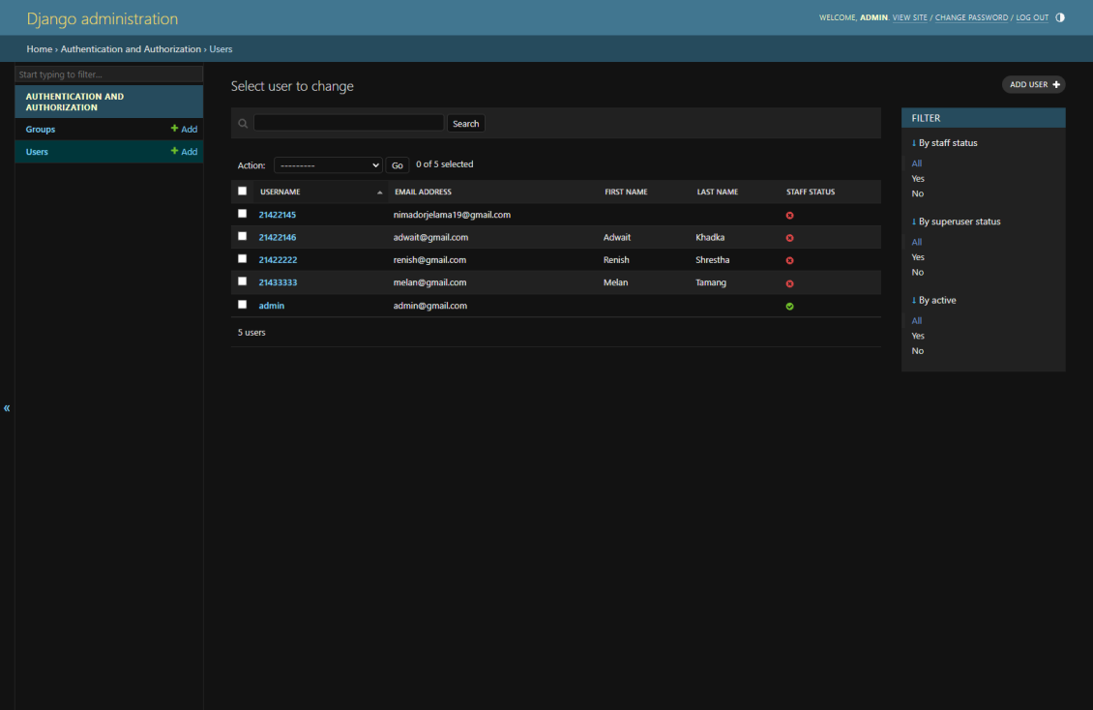

Slide 23
Progress till date
This is the end of my Presentation
Thank you….

Slide 24
thank you
Nima Dorje Lama
nimadorjelama19@gmail.comm

